Slide 1
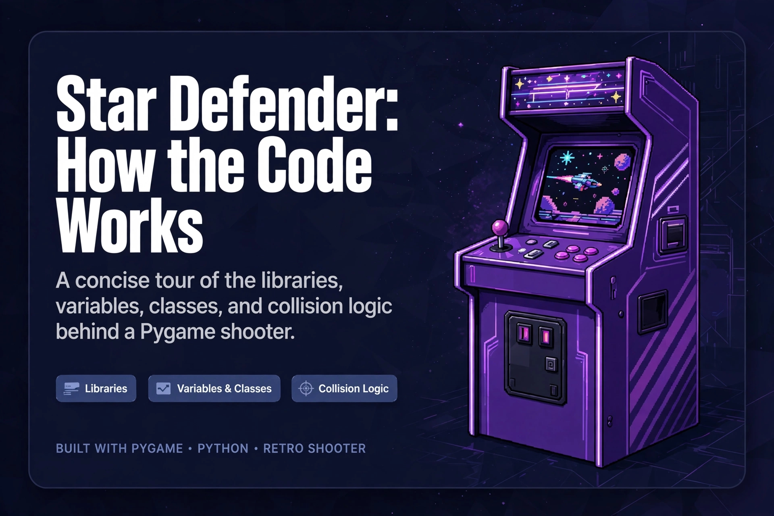
PYGAME SHOOTER
Star Defender:
How the Code Works
A concise tour of the libraries, variables, classes, and collision logic behind a Pygame shooter.
Notes:
Introduce the deck as a guided tour of the systems behind a small Pygame shooter. The focus is how the parts cooperate, not a full code listing.

Slide 2
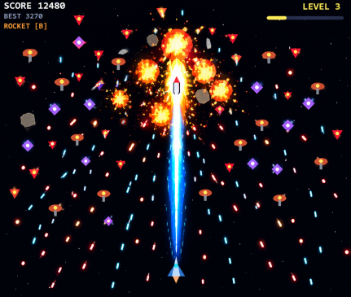
STARDEFENDER-The Rescue Mission
In the depths of space, a spaceship races toward a distant planet where a team of astronauts has been kidnapped by dangerous aliens.
Enemy spaceships emerge from the darkness, launching attacks from every direction. Lasers flash across space as the ship dodges incoming fire and blasts through waves of enemies.
You only have bullets or limited rockets to make your to the planet.
With every enemy defeated, the chance of reaching the planet is reducing as the boss of aliens are ready to join the battle.
One spaceship. Countless enemies. One mission: reach the planet and rescue the captured team or be dead on the way to planet.

Slide 3
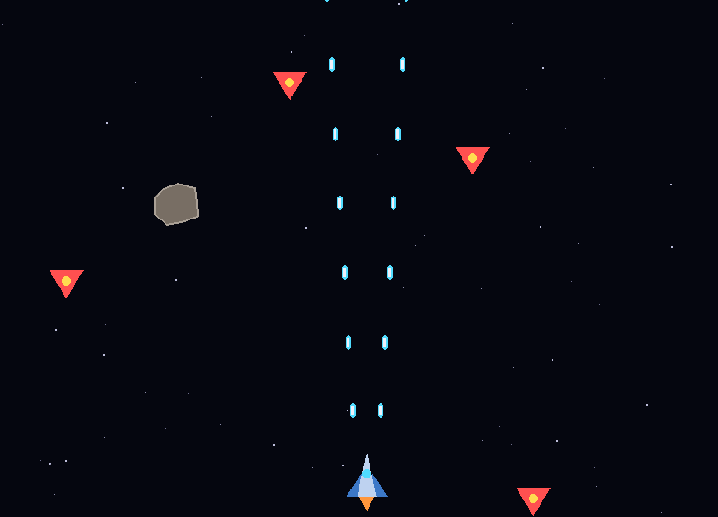
01 · PYGAME
Pygame handles the window, keys, and timing
Window: pygame.display.set_mode creates the screen.
Keyboard: pygame.key.get_pressed reports which keys are held.
Drawing: pygame.draw paints rectangles, circles, and polygons.
Timing: a Clock keeps the loop near FPS frames per second.
self.screen = pygame.display.set_mode((WIDTH, HEIGHT))
self.clock = pygame.time.Clock()
keys = pygame.key.get_pressed()
if keys[pygame.K_SPACE]:
Notes:
pygame owns the game window and real-time interaction. Point out that set_mode creates the screen, get_pressed is checked every frame, and the Clock limits the frame rate.

Slide 4
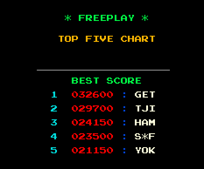
02 · JSON
JSON stores the high score and mute setting
Format: JSON is plain text with keys and values.
Load: json.load turns the saved file into a Python dictionary.
Save: json.dump writes the two values when the game needs them kept.
Safety: a missing or broken file falls back to defaults.
data = json.load(f)
self.high_score = int(data.get("high_score", 0))
json.dump({"high_score": self.high_score, "muted": self.muted}, f)
Notes:
json reads and writes the save file. SaveData.load runs at startup, and save runs on mute, game over, and quit.

Slide 5
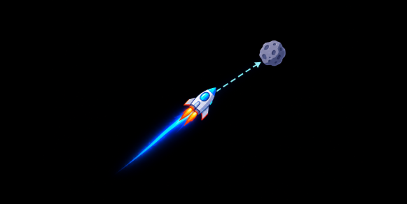
03 · FILES AND MATH
os locates the save file; math sets the geometry
os
math
Builds a file path that sits next to the script.
SAVE_FILE = os.path.join(os.path.dirname(os.path.abspath(__file__)), "savedata.json")
Measures distance and turns angles into motion.
dist = math.hypot(dx, dy) or 1
vx = dx / dist * speed
Notes:
os.path.join builds a safe path to savedata.json. math.hypot measures the distance from an enemy bullet to the player, then the bullet is steered toward that target.

Slide 6
04 · RANDOM, ARRAY, SYS
Three more libraries add variety, sound, and exit
random
array
sys
Varies spawns, stars, and particles.
self.dir = random.choice((-1, 1))
Stores raw audio samples for synthesised sounds.
buf = array.array("h")
buf.append(int(v * 32767))
Ends the program cleanly after saving.
sys.exit()
Notes:
random adds variation, array holds the sound samples that SoundManager builds, and sys.exit closes the program in quit().

Slide 7
WIDTH, HEIGHT, FPS
POINTS_PER_LEVEL
05 · RULES
Screen size and target
frame rate.
300 points advances the level.
Constants make the rules easy to change
Named constants keep game balance and presentation decisions in one place.
START_LIVES / MAX_LIVES
Colors and states
Shared visual values plus TITLE, PLAYING, PAUSED, GAME_OVER.
Player life limits.
Notes:
Constants turn scattered decisions into named controls. If the frame rate, level threshold, or life limit changes, the rule changes in one clear place.

Slide 8

06 · STRUCTURE
Classes model the game world
Game
Player, Enemy, Bullet, Rocket
Owns the main state, objects, input, updates, and drawing.
Interactive actors with position, movement, and rendering.
PowerUp, Particle, Starfield
SaveData, SoundManager
Effects and background systems.
Persistence and audio services.
Each class bundles data with the behavior that changes it.
Notes:
Game is the coordinator. The actors own movement and rendering, effects handle visual atmosphere, and SaveData and SoundManager provide services outside the immediate play space.

Slide 9
07 · STATE
Variables carry state through each frame
State is the information that changes while the game runs.
01
02
03
04
Position
Progress
Timers
Collections
x, y, vx, vy, rect.
score, level, hp, lives, rockets.
cooldown, invulnerable, rapid, shield,spawn_timer.
bullets, enemies, powerups, particles.
Timers count down with dt and switch abilities off when they reach zero.
Notes:
Every frame reads and updates state. Positions move, progress changes, timers expire, and collections gain or remove objects.

Slide 10
08 · MOTION
Input and timing drive movement
Held keys produce horizontal and vertical direction values.
Diagonal movement is normalized so it is not faster.
Position changes use SPEED × dt.
Player coordinates are clamped to the playable area.
MOVEMENT EXTRACT
self.x += dx * self.SPEED * dt
self.y += dy * self.SPEED * dt
Notes:
Input supplies direction, normalization keeps diagonals fair, and dt makes the same movement work even when frame timing varies. Clamping keeps the player inside the playable area.

Slide 11




09 · RULES IN MOTION
Collisions turn movement into gameplay
Rectangles make contact testable. The result of contact changes the game.
These shapes are enabled through pygame
Hitboxes
Defense
Every object owns a pygame.Rect hitbox.
Enemy or enemy bullet versus player triggers shield, damage, or game over.
Attack
Power-ups
Bullet versus enemy reduces hp and
can destroy the enemy.
Power-up overlap activates rapid fire, shield,
or an extra life.
Notes:
A collision is a bridge between geometry and rules. The same rectangle test can damage an enemy, protect a player, end a run, or activate a power-up.

Slide 12

10 · PROGRESSION
Progression connects scoring to difficulty
Destroying enemies adds their point value to score.
Higher levels shorten spawn delays and add zigzag and gunner enemies.
New levels can reward an extra rocket.
LEVEL FORMULA
score // POINTS_PER_LEVEL + 1
One formula controls both feedback and challenge growth.
Notes:
Score is more than a number on screen. It becomes level state, and level state changes spawn timing, enemy variety, and sometimes the player's rocket supply.

Slide 13
11 · BETWEEN RUNS
Persistence keeps the experience between runs
SaveData turns a single session into a continuing experience.
Start
Recover
SaveData.load() reads JSON when the game starts.
Missing or invalid data falls back to safe defaults.
Write
Trigger
save() writes high_score and muted settings.
Saving occurs on mute, game over, and quit.
SAVE EXTRACT
json.dump({"high_score": self.high_score, "muted": self.muted}, f)
Notes:
Persistence has a safe path and a write path. The game loads what it can, uses defaults when needed, and saves at moments when the player expects settings and score to survive.

Slide 14
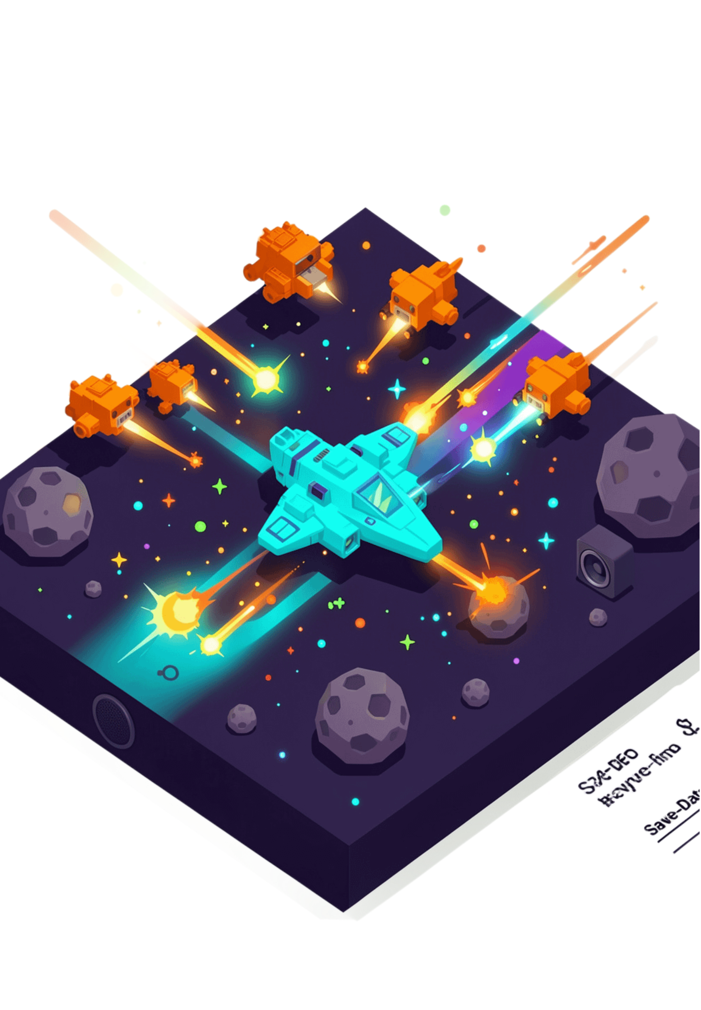
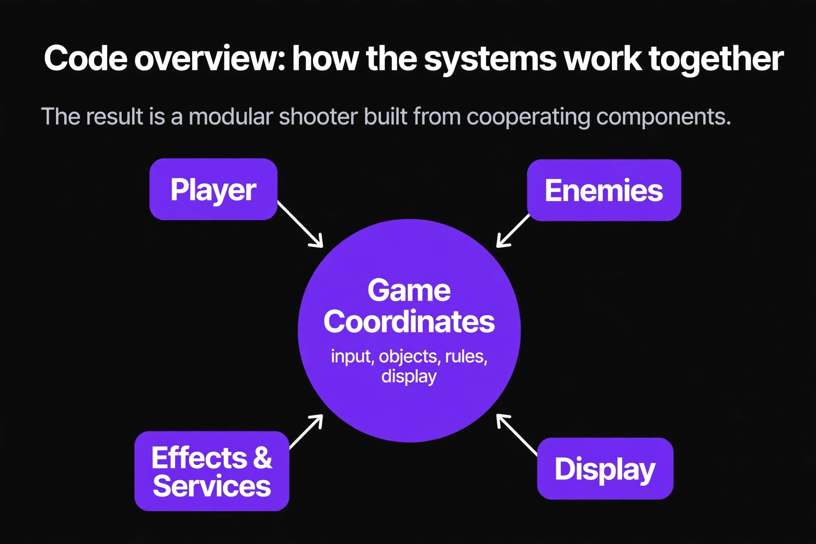

12 · THE WHOLE SYSTEM
Code overview: how the systems work together
The result is a modular shooter built from cooperating components.
Player
Movement, health,
attacks
Enemies
Movement, health,
behaviors
Game
Coordinates input, objects, rules, display
Effects & Services
Particles, stars, sound, settings
Display
Window, drawing,
timing
Notes:
Close by returning to the architecture. Game coordinates input, objects, rules, and display. Focused classes make the shooter easier to extend because each responsibility has a clear home.

